Slide 1
Lecture 19: Review for Final exam
Jibo He
Jibo.he@wichita.edu
Associate Professor
Wichita State University

Slide 2
Exam 4 contents
Two-sample t-test
Independent vs. dependent sample t-test
ANOVA
Omnibus F-test
Null and alternative hypothesis
Fill out the ANOVA table
Remember the three assumptions of ANOVA

Slide 3
A check-up about ANOVA
A researcher has been hired by a pizzeria to determine which type of crust is most preferred by customers. The restaurant offers three types of crust: hand-tossed, thick, and thin. Following are the means for each condition, from 30 participants who tasted each type of crust and rated them on a 1-10 scale with 10 as the highest rating. The ANOVA summary table also follows.
Crust Type | Mean | n
Hand-tossed | 2.73 | 10
Thick | 4.20 | 10
Thin | 8.50 | 10

Slide 4
State the null hypothesis for an ANOVA testing the significance of the differences between means.
Complete the ANOVA table
What is the critical value of F? Assume α=.01. State your decision.

Slide 5
Compute the effect size, η², and give your interpretations.

Slide 6
Conceptual questions
Identify independent and dependent variables
Two sample t-test
Standard error of the difference
The sampling distribution of differences between means
What is the pooled estimate of variance? When do you need to use it?
What is “homogeneity of variance” assumption? When can this assumption be overlooked?
How tobs is computed, and what is the meaning of tobs

Slide 7
Possible questions 1
An experimenter studies the effect of type of music during practice
on recall of word lists using rock background music for 20 subjects,
classical music for 22 others, and country/western for another 25.
How many levels are there in the experiment?
a. | 3 | c. | 20
b. | 67 | d. | 1
Notes:
Answer: A

Slide 8
Possible questions 2
What is the standard error of the difference?
a. | The standard deviation of the sample means.
b. | The standard deviation of the sampling distribution of the mean.
c. | The standard deviation of the sampling distribution of the mean differences.
d. | The pooled standard deviation from the populations from which the samples are drawn.
Notes:
Answer: C

Slide 9
Possible questions 3
What does tobs indicate in an independent samples t-test?
a. | The probability of rejecting the null hypothesis
b. | The probability of retaining the null hypothesis
c. | The location of the population mean difference, - , relative to the mean of the sampling distribution of mean differences
d. | The location of the sample mean difference relative to the mean of the sampling distribution of mean differences in standard error of the difference units
Notes:
Answer: D

Slide 10
Possible questions 3
What does tobs indicate in an independent samples t-test?
a. | The probability of rejecting the null hypothesis
b. | The probability of retaining the null hypothesis
c. | The location of the population mean difference, - , relative to the mean of the sampling distribution of mean differences
d. | The location of the sample mean difference relative to the mean of the sampling distribution of mean differences in standard error of the difference units
Refer to Lecture 14 – slide 16.
Correct answer is D
Notes:
Answer: D

Slide 11
Possible questions 4
Independent vs. dependent sample t-test
When one has the option, a related samples design should be chosen over an independent samples design because
a. | related samples result in more variability, and therefore the design is more powerful.
b. | related samples result in less variability, and therefore the design is more powerful.
c. | related samples designs are simpler to use.
d. | related samples designs are intrinsically better than independent samples designs.
Notes:
Answer: B

Slide 12
Review for final exam

Slide 13
Final exam
Final exam will worth 150 points
20 multiple choice question (5 points each)
5 complete sentence questions (4 points each)
2 computation/essay questions (15 points each)

Slide 14
Final exam content
It will cover all materials learned this semester, primarily focus on
Measure of central tendency/dispersion
Sum of the deviation scores is 0
Normal curve
The area under the curve is always 1
Linear transformation
Z-score
It explains “how far away a score is from the mean in standard deviation units?”

Slide 15
Mean and variance
Description of your data | Population | Sample
Mean
Variance
Standard deviation

Slide 16
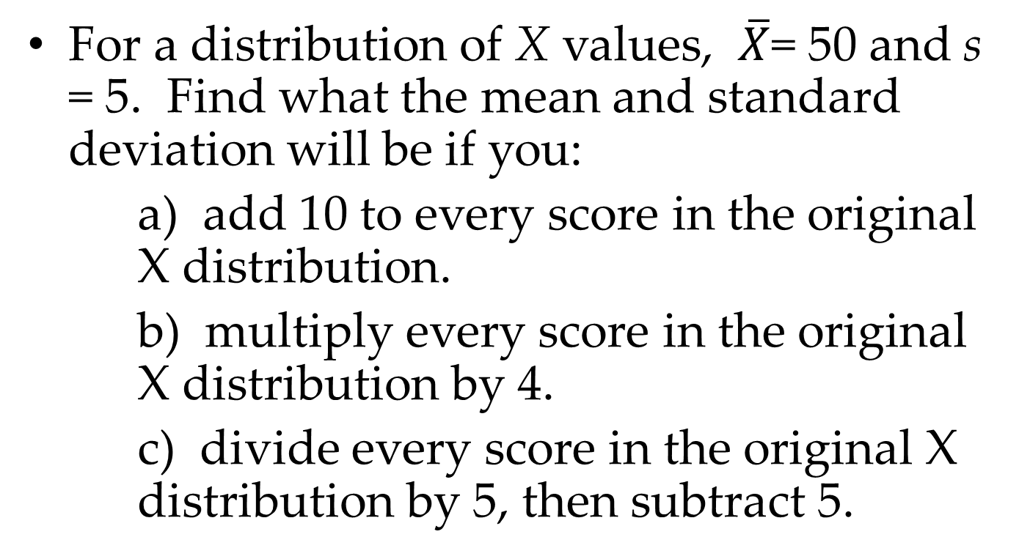
For a distribution of X values, $\overline{X}$= 50 and s = 5. Find what the mean and standard deviation will be if you:
a) add 10 to every score in the original X distribution.
b) multiply every score in the original X distribution by 4.
c) divide every score in the original X distribution by 5, then subtract 5.

Slide 17
In a normal distribution with µ = 100 and σ = 10
what proportion of scores fall between 90 – 110?

Slide 18

In a normal distribution with µ = 100 and σ = 10
what proportion of scores fall between 90 – 110?
Answer:

Slide 19
Probability
Probability
Sample space, event, random variable
Relationship between events
Mutually exclusive events
Exhaustive set of events
Independent events
# outcomes in some events__
# outcomes in sample space

Slide 20
Sampling with and without replacement
Conditional probability and Bayes theorem
Probability rules
Probability is bounded by 0 and 1
Sample space has a probability of 1
Mutually exclusive events P(A or B) = P(A) + P(B) or general addition rule P(A or B) = P(A) + P(B) – P(A and B)
Multiplication Rule for Independent Events
P(A and B) = P(A)P(B)
P(A and B) = P(A) P(B | A)

Slide 21
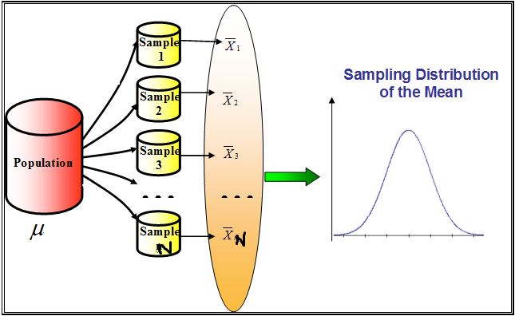
Sampling distribution and sampling error

Slide 22

Sampling Distributions
Central Limit Theorem
Given a population with mean µ and variance , the sampling distribution of the mean will have a mean equal to µ ( ), a variance equal to AAAA . The distribution will approach the normal distribution as n, the sample size, increases. (Howell, 2007).
$$σ^{2}$$

Slide 23
Suppose all of the third graders at Wilson Elementary School take a math test. The scores are normally distributed with μ = 75 and σ = 12.
(a) For the distribution of math test scores, what is the mean and standard error of the sampling distribution of the mean for samples of size 16?
(b) Suppose a sample of 16 third graders is selected from Wilson Elementary School. What is the probability that the mean math test score for the sample is greater than 81?

Slide 24

Suppose all of the third graders at Wilson Elementary School take a math test. The scores are normally distributed with μ = 75 and σ = 12.
(a) For the distribution of math test scores, what is the mean and standard error of the sampling distribution of the mean for samples of size 16?

Slide 25

Suppose all of the third graders at Wilson Elementary School take a math test. The scores are normally distributed with μ = 75 and σ = 12.
(b) Suppose a sample of 16 third graders is selected from Wilson Elementary School. What is the probability that the mean math test score for the sample is greater than 81?

Slide 26
Sample question on the final exam
21. The within-groups sum of squares is transformed into an estimate of the within-group variance by dividing the within-groups sum of squares by an appropriate number of ___________________.
Notes:
Degree of freedom

Slide 27
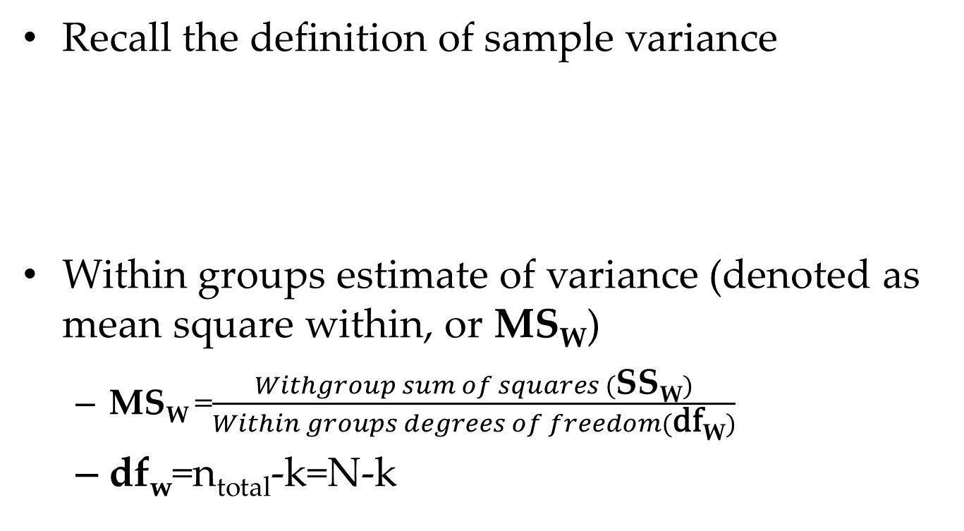
From sum of squares to estimates of variance
Recall the definition of sample variance
Within groups estimate of variance (denoted as mean square within, or MS_{W})
MS_{W} =$\frac{Withgroup sum of squares (\text{S}\text{S}\text{W})}{Within groups degrees of freedom(\text{df}\text{W})}$
df_{w}=n_{total}-k=N-k
Notes:
within-groups estimate of variance

Slide 28
Sample question on the final exam
21. The within-groups sum of squares is transformed into an estimate of the within-group variance by dividing the within-groups sum of squares by an appropriate number of ___(within-group)_degree of freedom_______________.
Notes:
Degree of freedom

Slide 29
The average score on a mandatory competency test for Westwood High School’s 500 sophomores is 400. Compute the 95% confidence interval if
a) we know that the population standard deviation on the test is 100.
b) we don’t know the population standard deviation, but we do know that the sample standard deviation is 120

Slide 30
Confidence Intervals for Population mean when σ is known
CI=Sample Mean ± Z×(?)
? Is standard error unit
If we have a confidence interval formula
means that if we calculated CIs using the above equation, the population parameter μ would be inside the confidence limits γ percent of time, in the long run.
Let us compute the 95% confidence interval for the previous example
Notes:
606+/-1.96*100/sqrt(225)=[592.9,619.1]

Slide 31
The average score on a mandatory competency test for Westwood High School’s 500 sophomores is 400. Compute the 95% confidence interval if
a) we know that the population standard deviation on the test is 100.
Answer: For 95% confidence interval, the critical Zcrit score is 1.96 The confidence interval is 400+/-1.96*100/sqrt(500)=[391.2346, 408.7654]

Slide 32
Confidence Intervals for Population mean when σ is unknown
(1-α)% Confidence Interval for μ when σ is unknown
As in hypothesis testing, we replace with and Z_{crit.} with t_{crit.}:
This will result in a somewhat wider confidence interval.

Slide 33

The average score on a mandatory competency test for Westwood High School’s 500 sophomores is 400. Compute the 95% confidence interval if
b) we don’t know the population standard deviation, but we do know that the sample standard deviation is 120.
Step 1:
Step 2: Next, we find the appropriate value of t_{crit}. In this case, we want to construct a 95% confidence interval, so α = .05. We are looking for a two-tailed t_{crit.}, so we look in our t table for an area of .025 in each tail for df = 500 – 1 = 500 – 1 = 499. We find t_{crit.} = ±1.964729.
Or in R code: > abs(qt(0.05/2, 499))
[1] 1.964729
Step 3:
Confidence interval is
[399.5285, 400.4715]

Slide 34
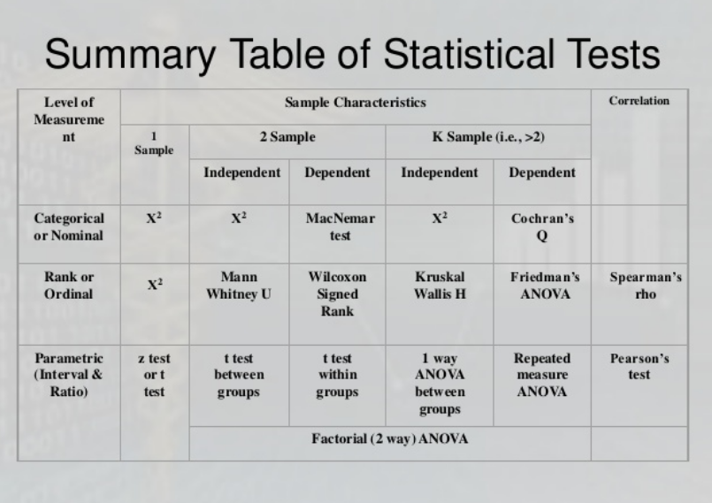

Slide 35
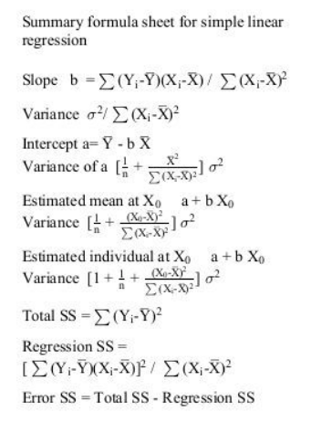

Slide 36
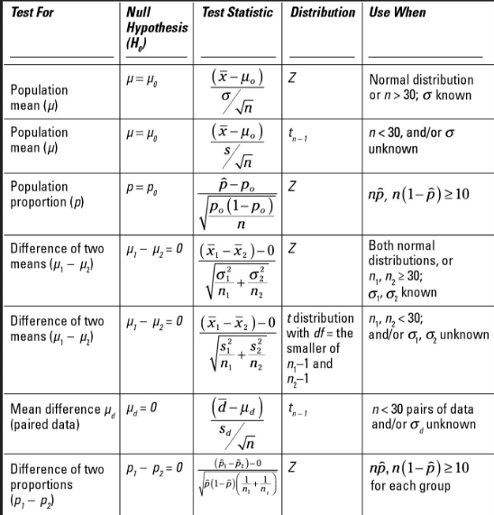

Slide 37
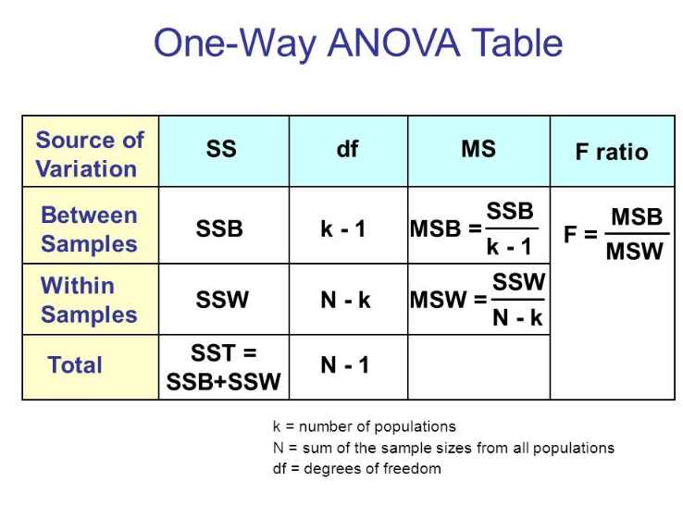

Slide 38

Final Exam! You are the BEST!

